Slide 1


Slide 2

Towards Real-time NVMe monitoring (nvme-top) for Linux
Speaker: Nilay Shroff, Daniel Wagner
Event: Linux Plumbers Conference (LPC) 2025

Slide 3
Motivation
NVMe monitoring today:
  nvme-cli provides only static snapshots
  Operators must manually rerun commands
  Debugging multipath or fabrics issues is slow and reactive
In NVMe-oF deployments:
  Path performance changes dynamically
  ANA state can fluctuate
  Congestion, latency spikes, or link failures are common
Operators need continuous visibility — not snapshots.

Slide 4
nvme-top UI Design
Two-level dashboard design:
Level 1 — Subsystem Summary
  Namespaces, controllers, paths
  IOPolicy (numa, queue-depth, rr)
  Aggregate IOPS, BW, latency
  Utilization
Level 2 — Drill-Down Detail
  Namespace-level stats
  Path performance
  Path health (ANA, retries, failovers etc.)
  Controller summary
All updated in real time.

Slide 5
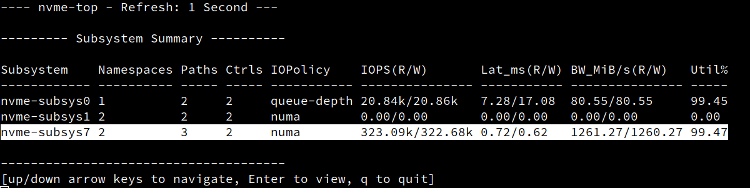
Level 1: Subsystem Summary
Displayed Metrics:
Namespaces: Num of namespaces
Paths : Num of paths
Controllers : Num of controllers
I/O Policy : numa, round-robin, queue-depth
IOPS : Total IOPS aggregated across all ns per subsystem
Latency : Max latency observed across all ns during the sample interval
Bandwidth : Total bw aggregated across all ns per subsystem
Utilization% : Max utilization among all ns during the sample interval.
User Interaction:
Up/down arrow key to navigate
Enter to expand
q to quit
Notes:
*IOPS(R/W): Total read/write IOPS, aggregated across all namespaces within the subsystem.
*Lat_ms(R/W): Maximum read/write I/O latency (in milliseconds) recorded during the last sample interval. If a subsystem contains multiple namespaces, the value shown is the maximum latency observed across all namespaces during the sample interval.
*BW_MiB/s(R/W): Total read/write I/O bandwidth (in MiB/s) across all namespaces, in the given subsystem during the last sample interval.
*Util%: Maximum utilization percentage, defined as the fraction of time the device was actively processing I/O. For subsystems with multiple namespaces, this value represents the maximum utilization among all namespaces during the sample interval.

Slide 6
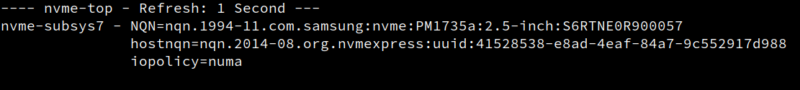
Level 2: Drill-Down (Header)
Displayed Metrics:
Refresh : Interval in seconds, user wants to refresh the stat
NQN : NVM Subsystem NVMe Qualified Name
hostnqn : Host NVM Subsystem NVMe Qualified Name
iopolicy : numa, round-robin, queue-depth

Slide 7
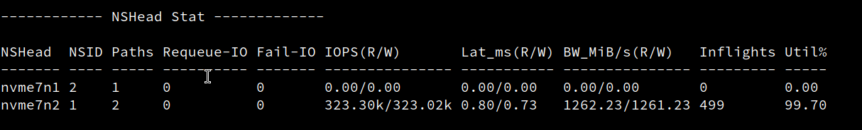
Level 2: Drill-Down: NSHead Statistics
Displayed Metrics:​
NSHead​ : Namespace head
NSID​ : Namespace ID
Paths : Num of I/O paths associated with this namespace head
Requeue-IO : Num of I/Os re-queued due to none of the available paths could process I/O currently (maybe due to transient error)
Fail-IO : Num of I/Os forced to fail due to no available paths
IOPS : Total read/write IOPS aggregated across all paths under this namespace head.
Latency : Avg. read/write latency across all paths for this NSHead during the last sampling interval.
Bandwidth : Total read/write bandwidth (in MiB/s) aggregated across all paths.
Inflights : Total number of in-flight I/Os aggregated across all paths.
Utilization% : Avg. device utilization across all paths associated with this NSHead.

Slide 8
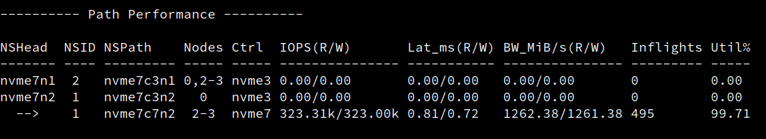
Level 2: Drill-Down: Path Performance
Displayed Metrics:
NSHead : Name of the namespace head
NSID : Namespace Identifier
NSPaths : Path name. If multiple paths exist, the same NSHead appears multiple times (it is represented with --> symbol).
Nodes : I/O originating from the list of NUMA nodes selects this path. (Displayed only when the I/O policy is numa)
Ctrl : Controller name to which this path belongs
IOPS : Read/write IOPS for the specific path.
Latency : Read/write Avg. I/O latency (in milliseconds) for this path during the last sample.
Bandwidth : Read/Write I/O bandwidth (in MiB/s) for this path.
Inflights : Current number of in-flight I/Os on this path.
Utilization% : Percent utilization of the specific path (fraction of time the controller was busy servicing I/O on this path).

Slide 9
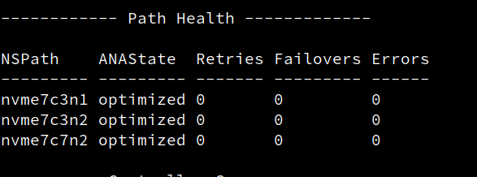
Level 2: Drill-Down: Path Health
Displayed Metrics:
NSPath : Path name
ANAState : ANA state value of the path
Retries : Number of I/O retries observed on this path
Errors : Number of I/O errors reported on this path
Failovers : Number of times I/O switched from this path to another path (meaningful only when a ns is reachable from multiple paths)

Slide 10
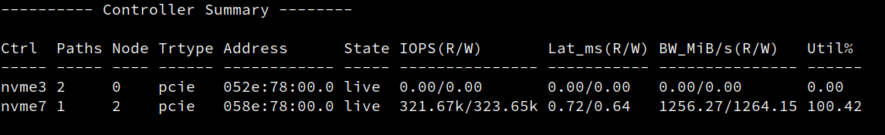
Level 2: Drill-Down: Controller Summary
Displayed Metrics:
Ctrl : Controller name
Paths : Number of I/O paths associated with the controller
Node : NUMA node local to the controller
Trtype : Transport type (e.g. pcie, tcp, rdma etc.)
Address : Transport address
State : Controller state (live, reconnecting etc.)
IOPS : Total read/write IOPS aggregated across all paths associated with the controller.
Latency : Max read/write I/O latency (in milliseconds) observed across all paths for the controller during the last sample interval
Bandwidth : Total read/write bandwidth aggregated across controller paths
Utilization% : Maximum disk utilization in percentage among the paths under this controller

Slide 11
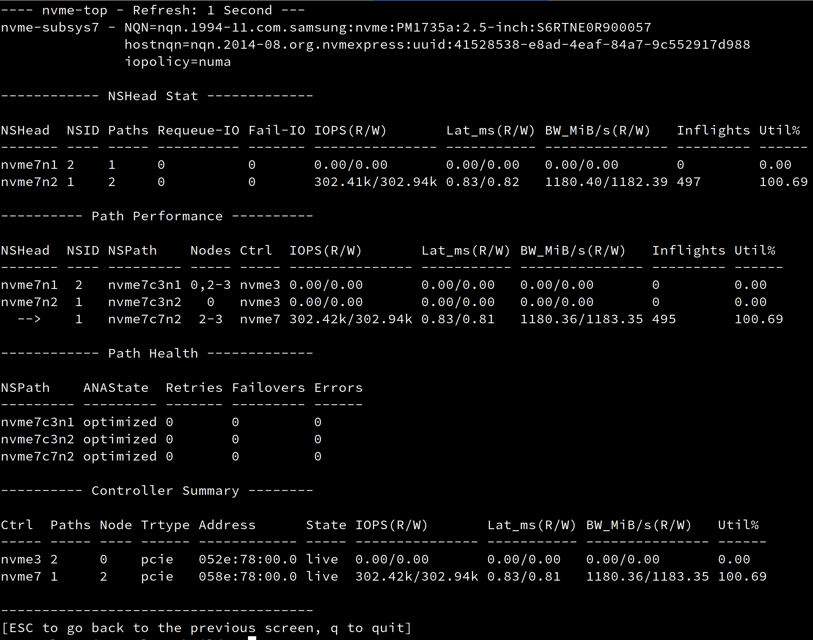
Level 2: Dashboard (multipath)

Slide 12
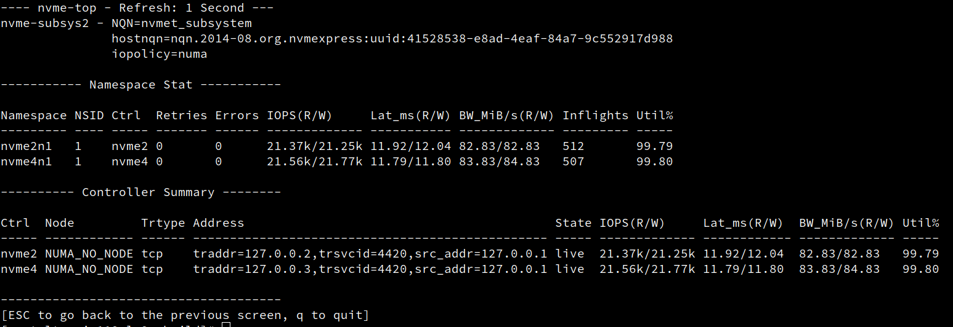
Level 2: Dashboard (non-multipath)

Slide 13
Implementation Details
Pure termios-based UI
  No ncurses dependency
  Low overhead
Why not ncurses?
  Simpler deployment
  No external libraries
  Faster redraw for small dashboards
  Easier integration into nvme-cli
Uses ANSI escape codes for:
  Cursor movement
  Screen clearing
  Row highlighting
Efficient delta (time interval) based redraw
Stats collection via libnvme / sysfs / ioctls

Slide 14
Call for Feedback
What metrics are missing/redundant ?
Suggestions for interactive features?
How should we handle large fabrics (>50 controllers)?
Update existing libnvme APIs ?
  fetch the latest attribute value (instead of re-using cached value)
  introduce new APIs for real-time update?
Polling vs. Notification-based Models
  Acceptable overhead?
  Should nvme-top wait for kernel events (inotify/fanotify or uevents)?
Keep simple ASCII TUI?
  Support curses / btop-style interface?
  Exporter mode for Prometheus/Grafana?
Qdepth is per-controller attribute
  Fix kernel to export qdept through controller sysfs attribute instead of per-path sysfs attribute?
Modify kernel to export following error counters?
  Failovers
  Errors
  Requeue-IOs
  Fail-IOs

Slide 15
Summary
nvme-top aims to:
  Provide real-time NVMe visibility
  Multipath-aware dynamic drill-down
  Improve debugging of NVMe-oF multipath
  Highlight path/controller imbalances
  Enable fast triage during fabric issues
  Lightweight terminal UI
  A practical debugging tool for NVMe-MP deployments
The goal of this BoF is to shape its future direction together with the community.

Slide 16
THANK YOU!​
Feedback and collaboration are welcome!

Slide 17
BACKUP

Slide 18
Existing Gaps
Tool | Limitation
nvme-cli | Static data, not real-time
iostat | Not NVMe multipath/topology aware
iotop | Not NVMe multipath/topology aware
Perf/eBPF | Low level not user friendly
Missing: A tool combining top-style interactivity with NVMe-specific awareness.

Slide 19
Why nvme-cli Alone Is Not Enough
Today:
  nvme list
  nvme list-subsys
  nvme get-log
  nvme ana-log
…but:
  Each output is static
  Structure is rebuilt from sysfs once per invocation
  No persistent in-memory state
  No incremental updates
  No live reactions to changing multipath conditions
To monitor fabric NVMe reliably:
  We need continuous updates.

Slide 20
What is nvme-top?
A proposed tool that provides:
  Real-time NVMe monitoring (e.g., refresh every second or at configured interval)
  Continuously updating dashboard, similar to top / iotop
  NVMe-aware views: subsystem, namespace, path, controller
Multipath intelligence:
  ANA state
  NUMA node affinity
  Queue depth (QDepth)
  Per-path latency + bandwidth
Goal: Improve operational visibility and reduce debugging time.

Slide 21
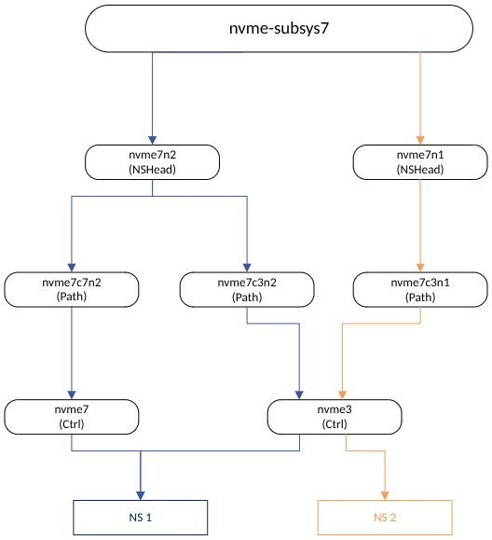
Topology multipath (nvme-subsys7)

Slide 22
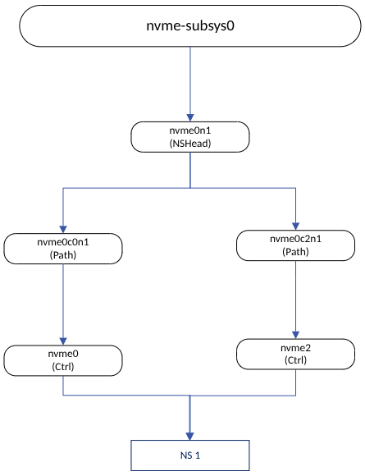
Topology multipath (nvme-subsys0)

Slide 23
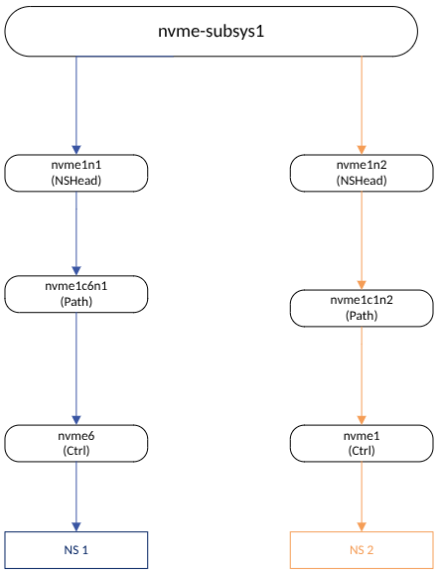
Topology multipath (nvme-subsys1)

Slide 24
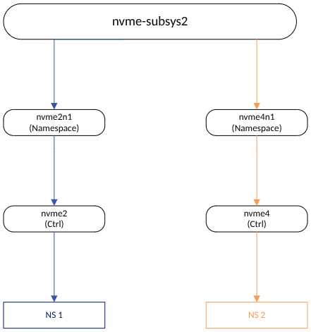
Topology non-multipath (nvme-subsys2)

Slide 25
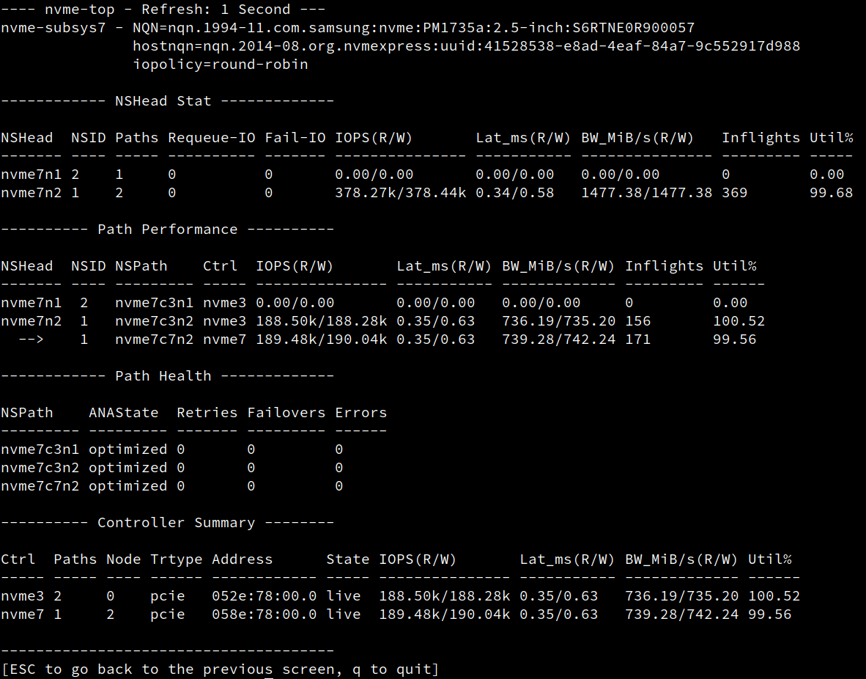
Level 2: Drill-Down (iopolicy=round-robin)

Slide 26
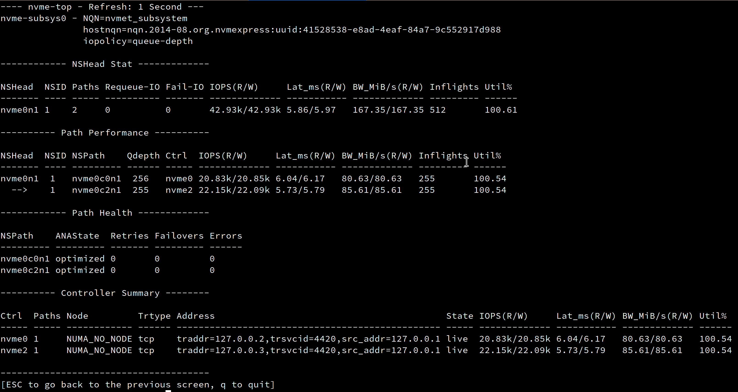
Level 2: Drill-Down (iopolicy=qdepth)

Slide 27
Why not ncurses?
Simpler deployment
No external libraries
Faster redraw for small dashboards
Easier integration into nvme-cli

